Slide 1


HR Analysis Using MySQL
HR analysis using MySQL typically involves extracting and analyzing data from various tables in an HR (Human Resources) database. This could include employee details, payroll data, attendance records, performance reviews, and more. By running SQL queries, you can gain valuable insights into the workforce, employee performance, payroll management, and trends related to employee retention, training, and recruitment.

Slide 2
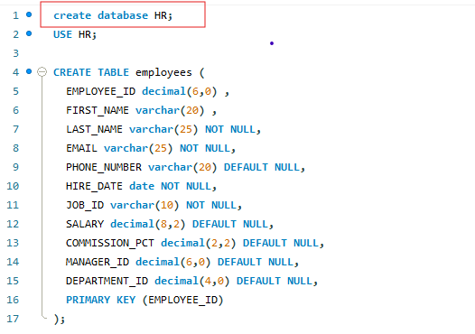
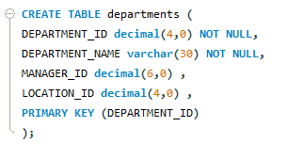
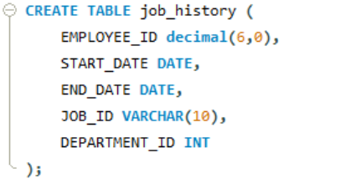
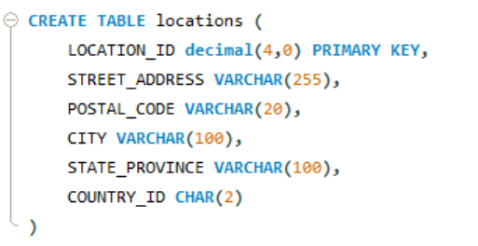
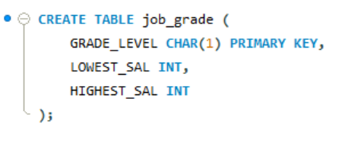
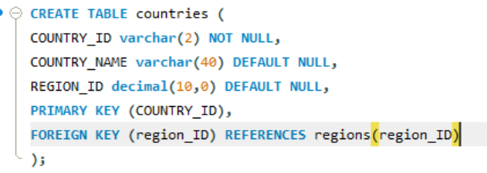
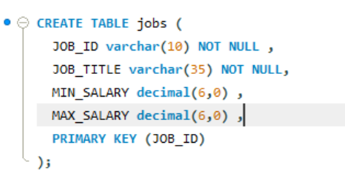
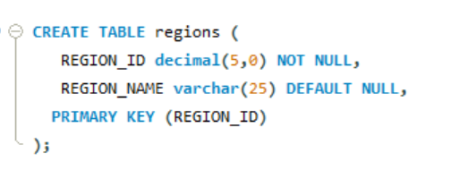
Created HR database – Created Employee, Departments, Jobs, Countries, locations, regions tables and inserted the values in it

Slide 3
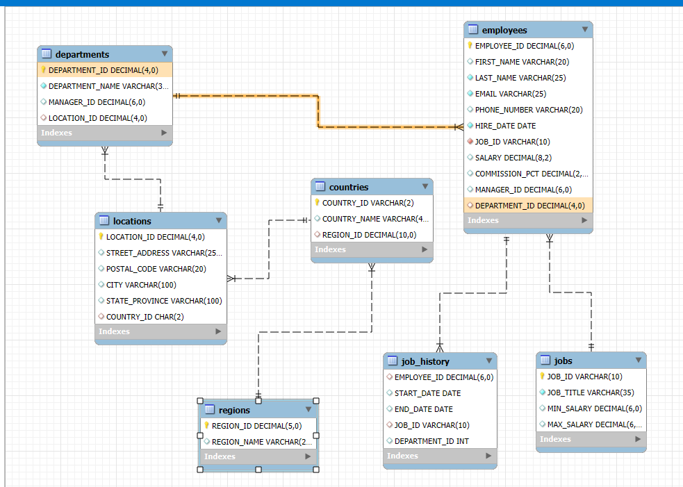

Entity-Relationship diagram

Slide 4
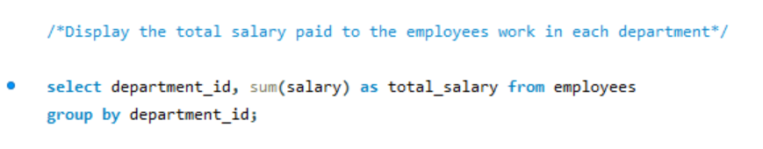
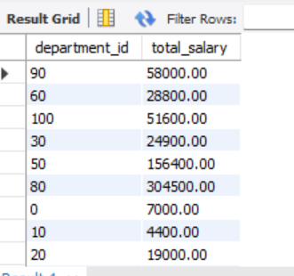
Display the total salary paid to the employees in each Department.

Slide 5
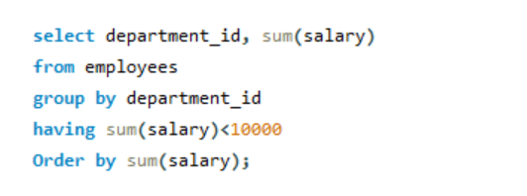
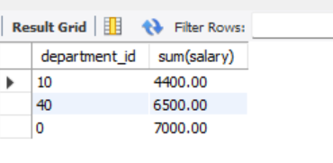
Show the total salary of depts where the total salary will not exceed 10000

Slide 6
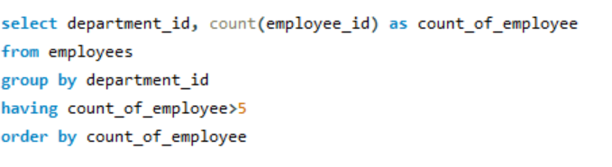
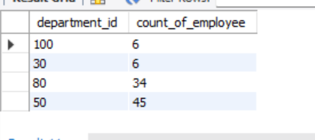
Find the department with more than 5 employee

Slide 7
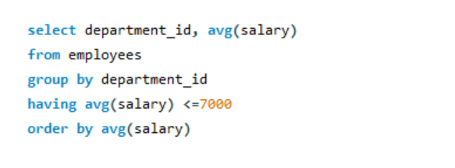
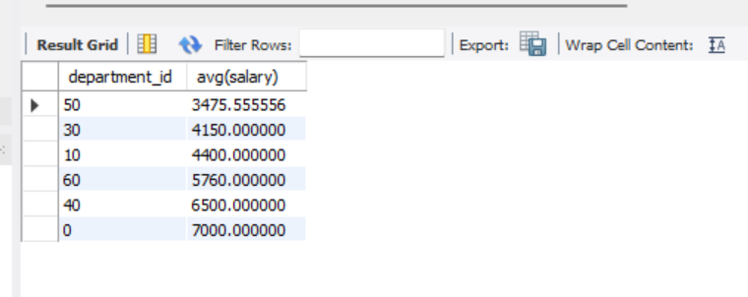
List the average salary of employee for each dept excluding the dept that have average salary above 7000

Slide 8
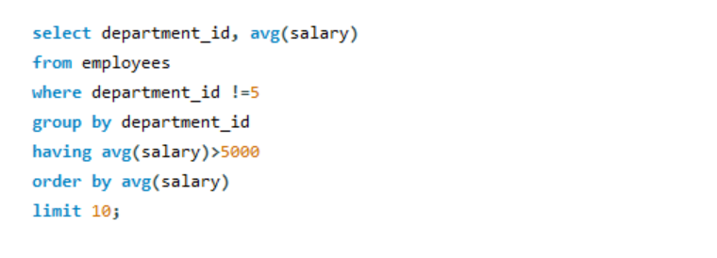
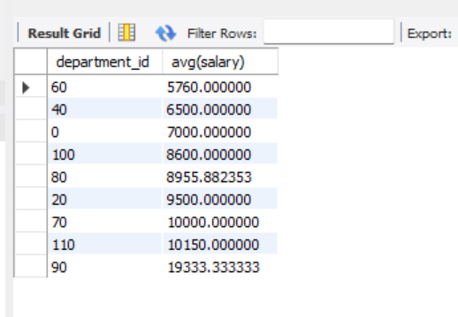
Find the Top 10 departments with an average salary above 5000 excluding the dept id 5 with limit of 10

Slide 9
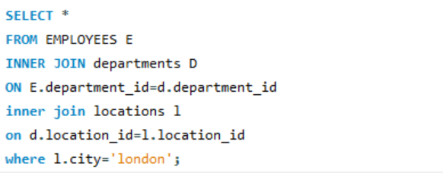

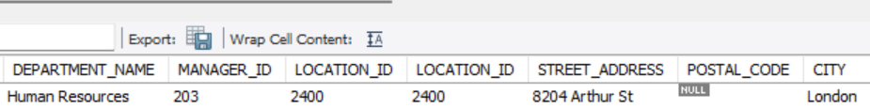
/*write a query that display the name, salary, deparment_name of the emp working in location=london*/

Slide 10
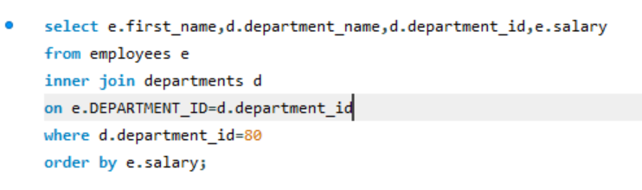
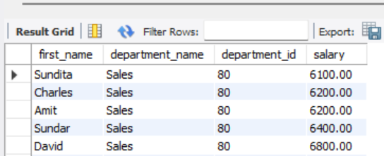
/*Write a query to display the name ,dept_name for all employees for department 80 */

Slide 11
Thank you
Asif Jahan
asif.gg@gmail.com

